Slide 1


In the name of Allah, the Beneficent, the Merciful
CSC312 / CSE312
Lecture 4: Software Quality Engineering
Activities & Process

Slide 2

Different customers and users have different quality expectations under different market environment
Our goal is to meet these quality expectations through the selection and execution of appropriate QA activities while minimizing the cost and other project risks under the project constraints

Slide 3

Different customers and users have different quality requirements
We need to move toward quality engineering by managing these quality expectations as an engineering problem
To ensure that quality goals are met, various measurements need to be taken parallel to the QA activities

Slide 4

There are three major groups of activities in the quality engineering process
  pre-QA Activities
  in-QA Activities
  post-QA Activities

Slide 5
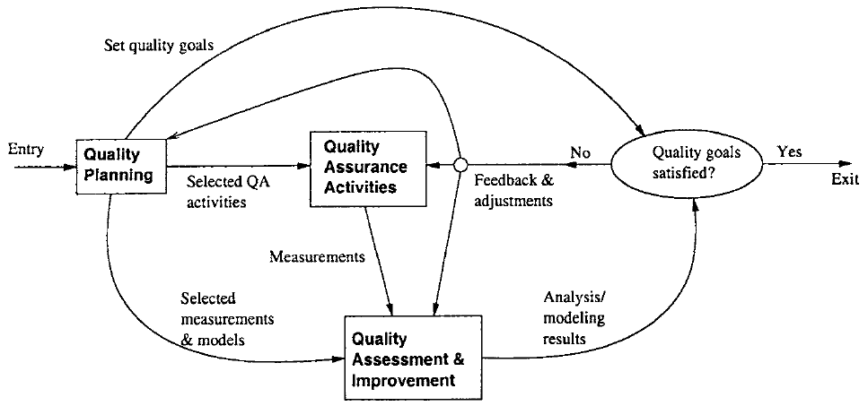
Main goal: defect prevention, defect reduction, and defect containment

Slide 6

pre-QA activities
  Quality Planning
in-QA activities
  Executing planned QA activities and handling discovered defects
post-QA activities
  Quality measurement, assessment and improvement

Slide 7

Quality Planning
  These activities should be carried out before carrying out the regular QA activities
There are two major types of activities in quality planning
  Set specific quality goals
  Form an overall QA strategy
    Select appropriate QA activities to perform
    Choose appropriate quality measurement

Slide 8

A Goal = SMART
  Specific
  Measurable
  Achievable
  Realistic
  Time-Framed
Example: User should be able to query for a book from online LMS in less than a second

Slide 9

Executing planned QA activities
  Formal design reviews
  Peer reviews
  Expert opinions
  Software testing
Handling discovered defects

Slide 10

Quality measurement, assessment and improvement
These are the activities that are carried out after normal QA activities have started
The primary purpose of these activities is to provide quality assessment and feedback
  various management decisions can be made
  possible quality improvement initiatives can be carried out

Slide 11

The quality engineering process forms an integral part of the overall software engineering process
Individual QA activities can be carried out and integrated into the software process
When we broaden our scope to quality engineering, it also covers pre-QA quality planning as well as the post-QA measurement and analysis activities

Slide 12

Pre-QA quality planning can be an integral part of any project planning
  Project planning typically includes decisions on languages, tools, and technologies to be used for the intended software product
In the waterfall model, this is typically carried out in the phase for market analysis, requirement gathering, and product specification

Slide 13
The specific analysis, feedback, and follow-up activities in the SQE process fit well into the normal software management activities
  Can be done as an integral part of SPM
Can be considered as an integral part of software project management

Slide 14
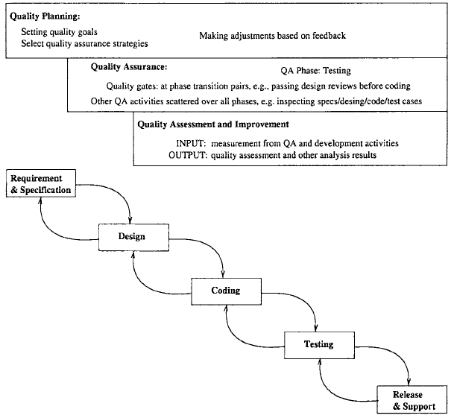


Slide 15

Among the three SQE activities, the execution of specific QA activities is central to dealing with defects and assuring quality
Therefore, they should and normally do consume the most resources
  Human effort, utilization of computing and so on
However, the effort distribution among the three is not constant over time

Slide 16

Quality planning drives and should precede the other two groups of activities
Quality planning should be the dominant part of SQE at the beginning
Thereafter, occasional adjustments to the quality goals and selected quality strategies might be applied, but only a small share of effort is needed

Slide 17

The collective effort of selected QA activities generally demonstrates the following pattern
  There is a gradual build-up process for individual QA activities
  The collective effort normally peaks off a little bit before product release
  Around product release and thereafter, the effort tapers off, typically with a sudden drop at product release

Slide 18

Measurement and quality assessment activities start after selected QA activities are well under way
Typically, at the early part of the development process, small amounts of such activities are carried out to monitor quality progress
These activities peak off right before or at the product release, and lower gradually after that

Slide 19
